Slide 1
Exploring Momentum Strategies in Health Care Stocks
Presentation by: Matt Soyk, Wan Yu Yu, Hyunsoo Cho

Slide 2
Data
Sourced data using yfinance library in Python
Used 22-year data for XLV ETF from its inception on Dec 22, 1998
Used data for underlying stocks of XLV from either date of inception for XLV, and for stocks that were listed after, from the date of their listing

Slide 3
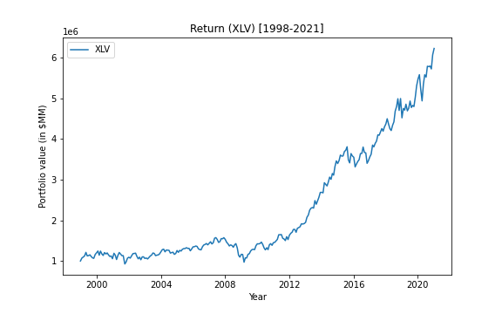
XLV
Mean: 7.6%
Stdev: 13.6%
Sharpe: 0.557

Slide 4
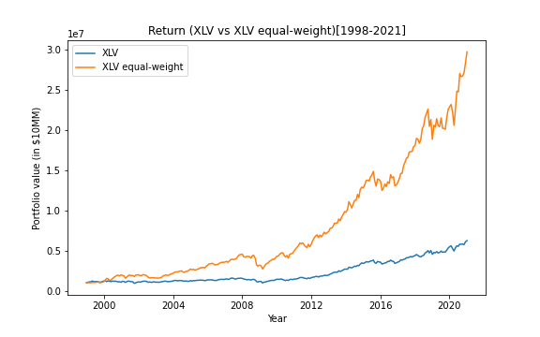
XLV Equal-Weighted
Mean: 16.7%
Stdev: 21.9%
Sharpe: 0.762

Slide 5
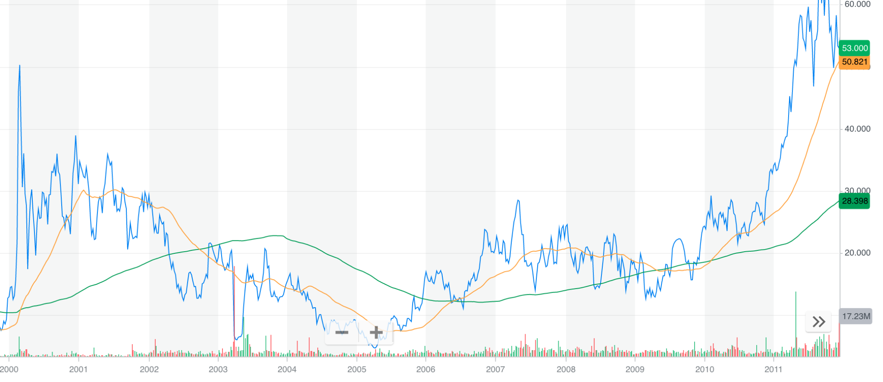
SMA
Compare 50-day and 200-day moving averages and trade at crossovers

Slide 6
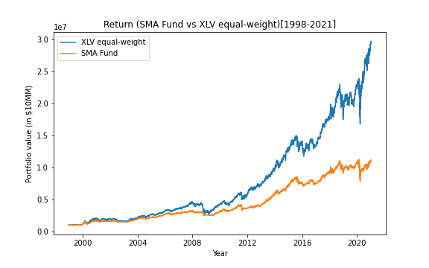
Simple Moving Average
Mean: 10.8%
Stdev: 17.0%
Sharpe: 0.636

Slide 7
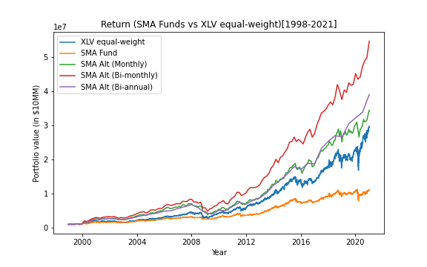
Simple Moving Average (Periodic)
 | Mean | Stdev | Sharpe
Monthly | .183 | .297 | .620
Bi-monthly | .214 | .347 | .618
Bi-annual | .188 | .270 | .696

Slide 8
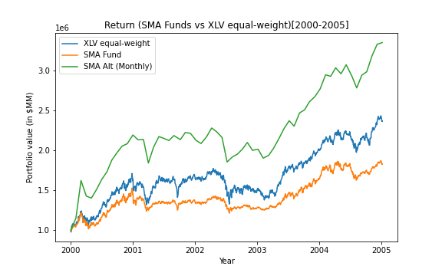
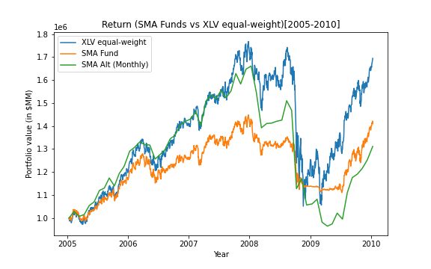
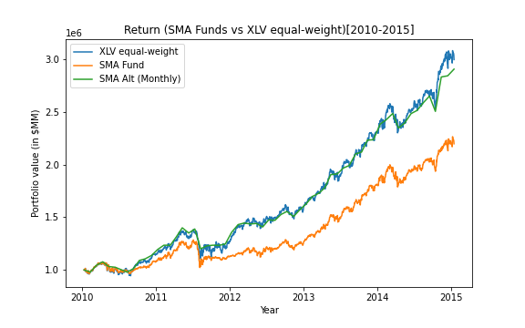
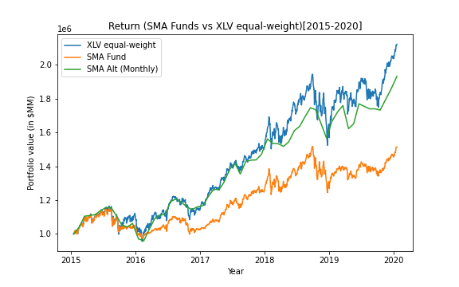
SMA 5 Year Split Return

Slide 9
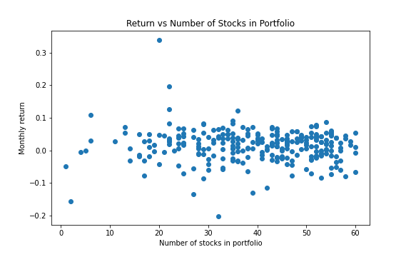
Return vs Number of Stocks

Slide 10
Moving Average Convergence Divergence (MACD)
exponential moving average (EMA): moving average that puts more weight on recent prices
MACD = 12 Period EMA - 26 Period EMA
signal line: 9 day EMA
buy when MACD is higher than signal line and sell when lower than signal line

Slide 11
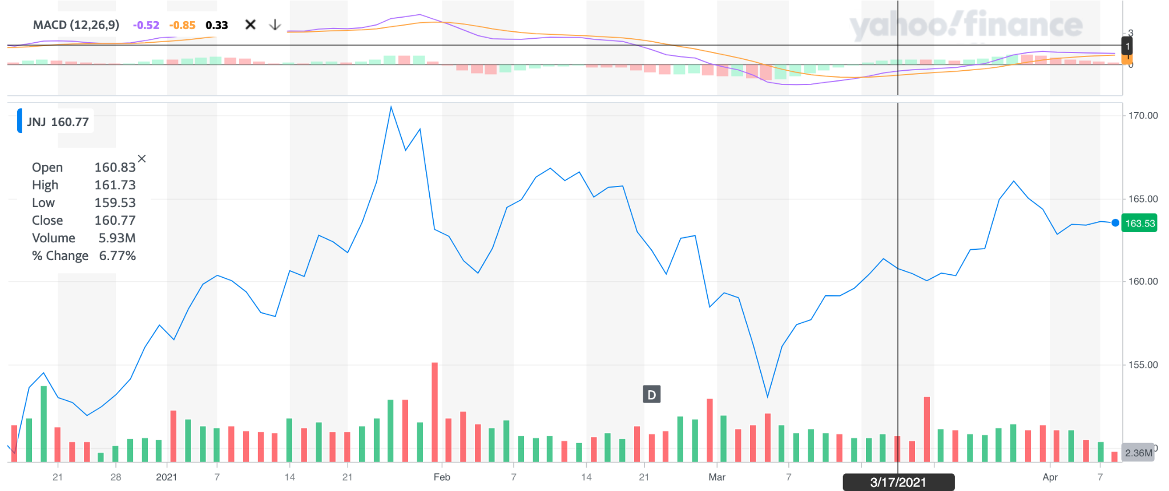

Slide 12
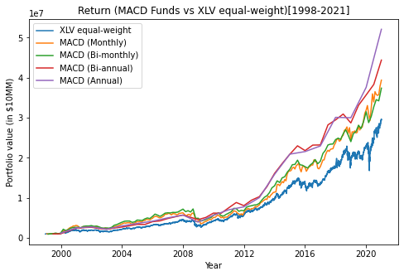
MACD: Return Graph

Slide 13
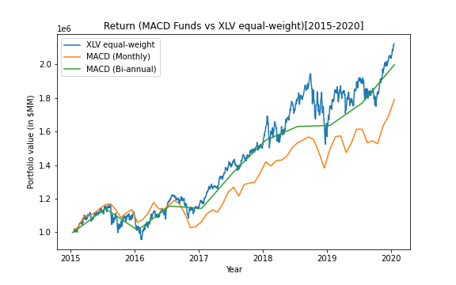
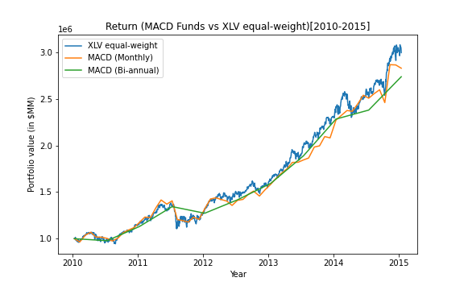
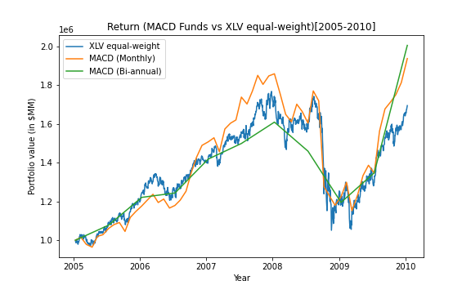
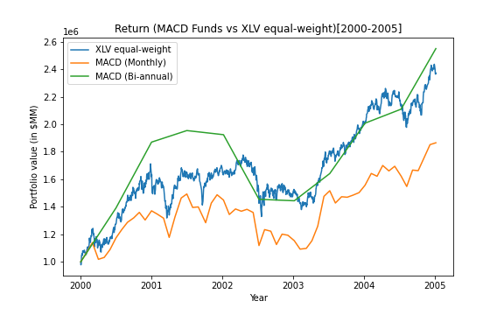
MACD 5 Year Split Return

Slide 14
MACD: Sharpe Ratio
0.614239
Monthly : 0.697618
Bimonthly : 0.587194
Biannually : 0.919992

Slide 15
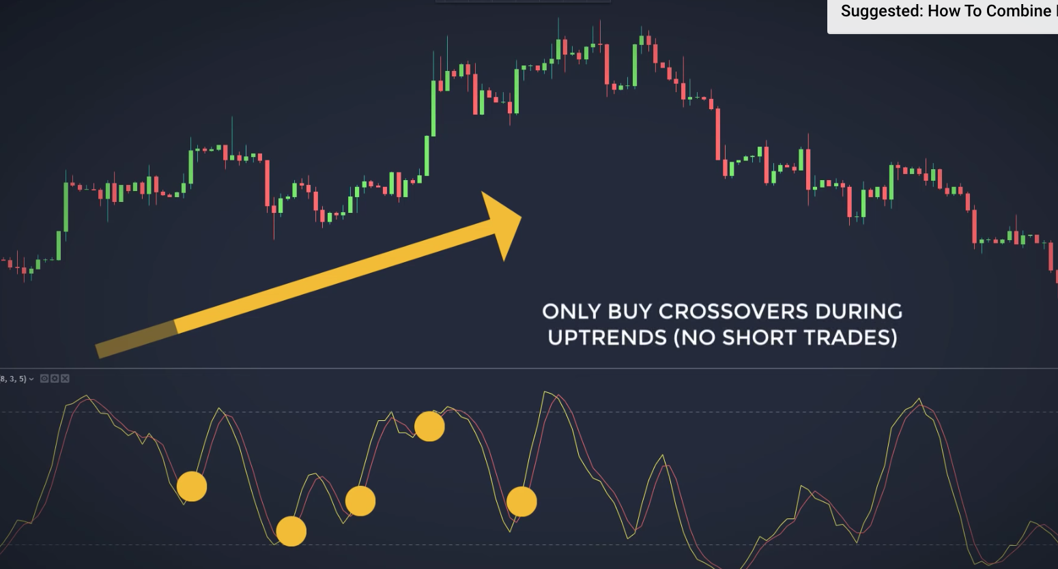
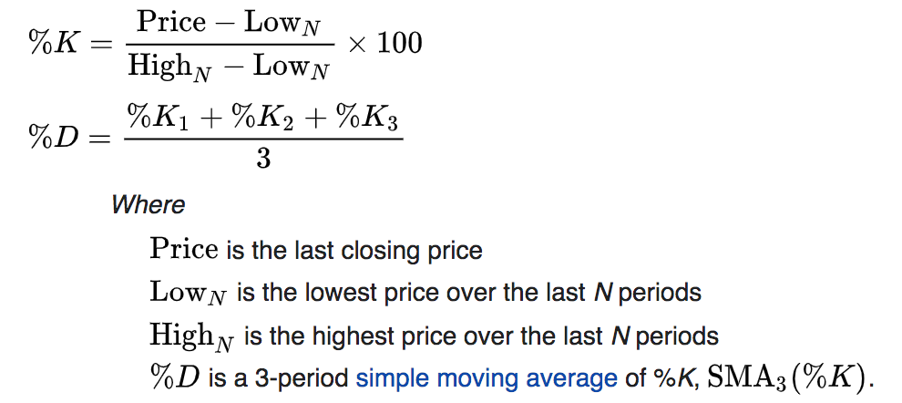
Stochastic Oscillator

Slide 16
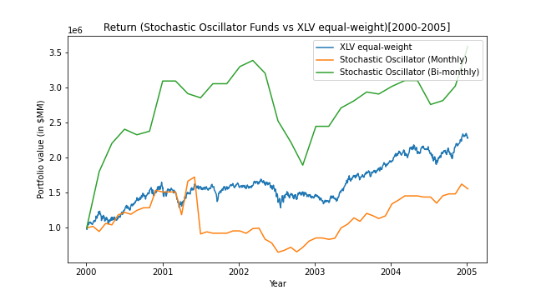
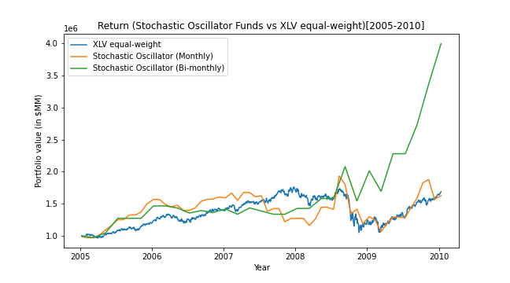
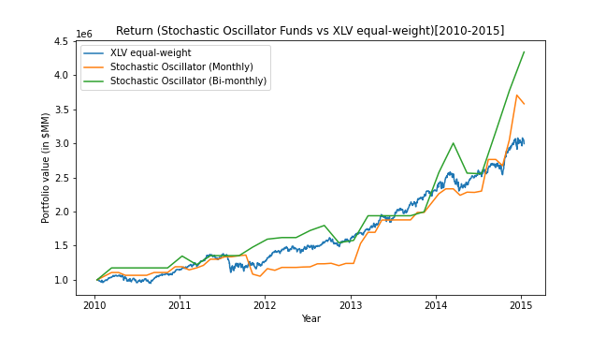
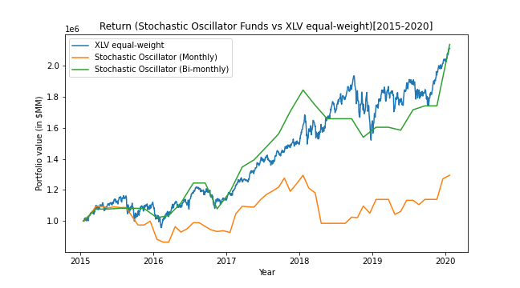

Slide 17
Monthly
Bi-monthly
Bi-annually
Mean: 22.4292%
Stdev: 26.7464%
Sharpe: 0.838589
Mean: 14.3341%
Stdev: 22.9257%
Sharpe: 0.62524
Mean: 13.5076%
Stdev: 27.6669%
Sharpe: 0.488221

Slide 18
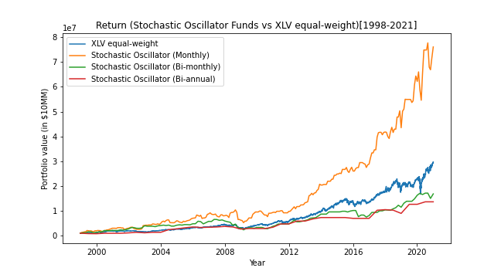
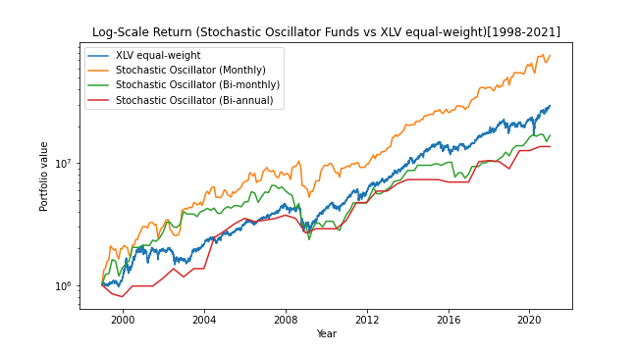

Slide 19
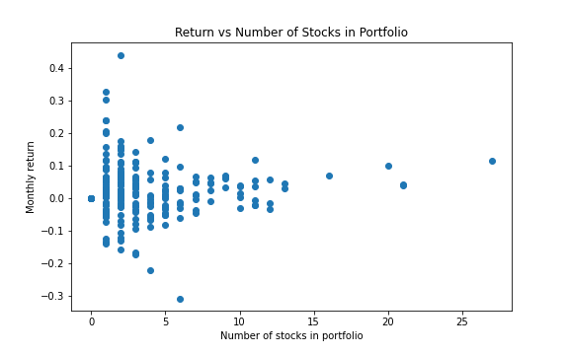

Slide 20
Conclusions and Future Work
Unable to conclusively determine a strategy that outperformed our benchmark portfolio in terms of Sharpe
SMA and MACD strategies seemed to give greater absolute return, but lagged far behind in terms of Sharpe
Stochastic oscillator strategies were more inconsistent in terms of performance
Certain strategies outperformed our benchmark in terms of absolute value and Sharpe, but we conclude that this a viable trading strategy since this outperformance could be limited to this basket of stocks or this period of time

Slide 21
References
Simutis. (2000). Fuzzy Logic Based Stock Trading System. Proceedings IEEE/IAFE conf. on Computational Intelligence of Financial Engineering, New York, 2000.

